Slide 1
Chapter 3
Image Transform: Frequency Domain Representation and Enhancement

Slide 2
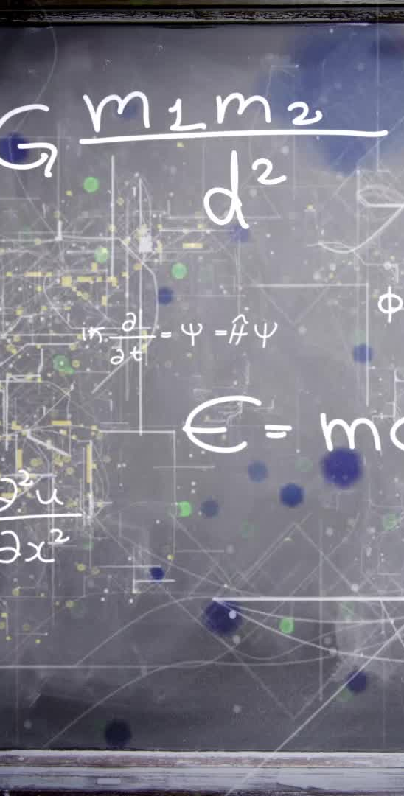
Syllabus
Image Transform: Frequency Domain Representation and Enhancement (10-CO3)
3.1 Introduction , DFT and its properties, radix-2 algorithm(2- DFT ), FFT algorithm: divide and conquer approach, Dissemination in Time(DIT)-FFT
3.2 Discrete Cosine Transform, Walsh Transform, Hadamard Transform, Haar Transform, Principal component Analysis(PCA/Hoteling Transform), Introduction to Wavelet Transform
3.3 Low Pass and High Pass Frequency domain filters: Ideal, Butterworth, Homomorphic filter
Self-Learning Topic: Discrete Sine Transform (DST)

Slide 3
Image Transforms
Extensively used in image processing and image analysis.
Transform is basically a mathematical tool, which allows us to move from one domain to another domain (time domain to the frequency domain).
Transforms change the representation of a signal by projecting it onto a set of basis functions.
The transforms do not change the information content present in the signal.

Slide 4
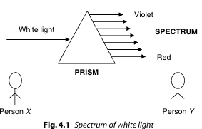
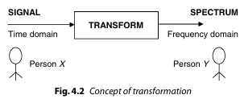
NEED FOR TRANSFORM
(i) Mathematical Convenience:
Every action in time domain will have an impact in the frequency domain.
The complex convolution operation in time domain is equal to simple multiplication operation in the frequency domain
(ii) To Extract more Information:
Transforms allow us to extract more relevant information.

Slide 5
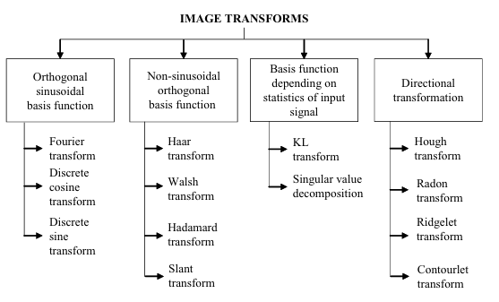
Classification of Image Transforms

Slide 6
Image Transform
1) Orthogonal sinusoidal basis function
One of the most powerful transforms with orthogonal sinusoidal basis function is the Fourier transform.
The transform which is widely used in the field of image compression is discrete cosine transform.

Slide 7
Image Transform
2) Non-sinusoidal orthogonal basis function
The transforms whose basis functions are non-sinusoidal in nature.
One of the important advantages of wavelet transform is that signals (images) can be represented in different resolutions.

Slide 8
Image Transform
3) Basis function depending on statistics of input signal
The transform whose basis function depends on the statistics of input signal are KL transform and singular value decomposition.
The KL transform is considered to be the best among all linear transforms with respect to energy compaction.

Slide 9
Image Transform
4) Directional transformation
The transforms whose basis functions are effective in representing the directional information of a signal include Hough transform, Radon transform, Ridgelet transform and Contourlet transform.

Slide 10
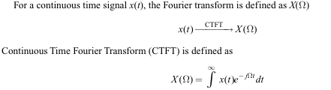
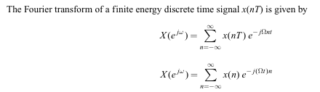
FOURIER TRANSFORM
Fourier transform is widely used in the field of image processing.
A Fourier transform is used to transform an intensity image into the domain of spatial frequency.
A continuous time signal x(t) is converted into discrete time signal x(nT ) by sampling process, where T is the sampling interval

Slide 11



A continuous time signal x(t) is converted into discrete time signal x(nT ) by sampling process, where T is the sampling interval
Where X(ejω ) is known as Discrete-Time Fourier Transform (DTFT) and is a continuous function of ω. The relation between ω and Ω is given by
ω = ΩT
ω =2πf ×T
where T is the sampling interval and is equal to 1/ fs . Replacing T by 1/ fs in above equation we get
ω = k × 2π
To limit the infinite number of values to a finite number, above equation is modified as ω/2π= k/N

Slide 12
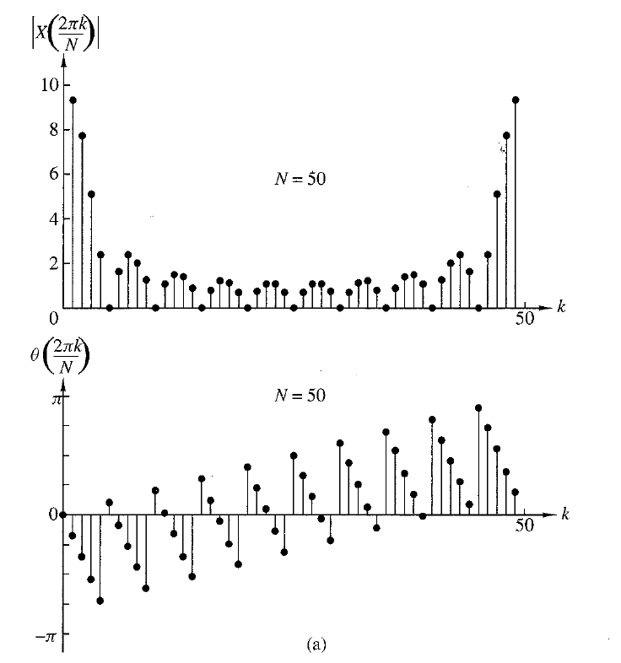
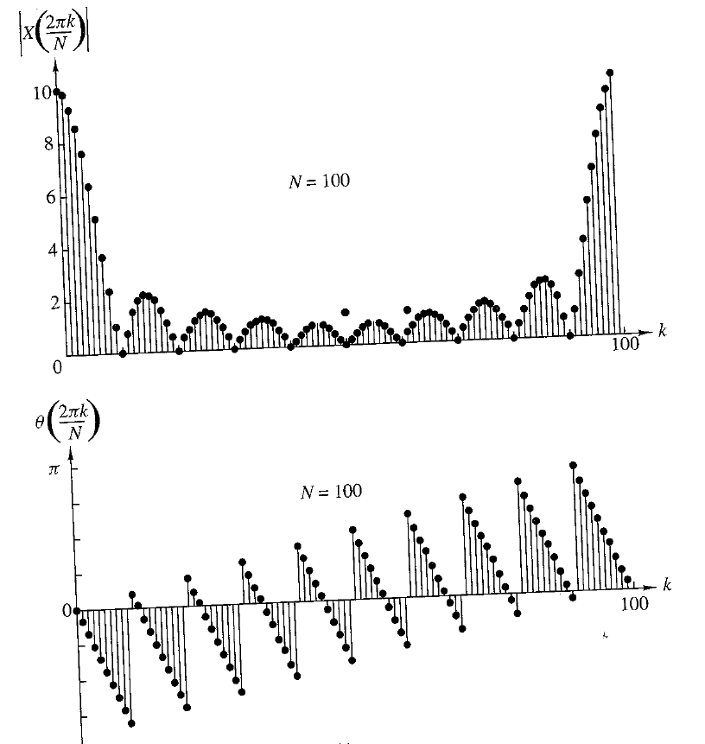
Discrete Fourier Transform

Slide 13

Discrete Fourier Transform

Slide 14

Discrete Fourier Transform
Discrete Fourier transform for a finite sequence is given by:
Evaluating summation for finite sequence for 0 to N-1.
k/N corresponds to frequency F
N corresponds to time for discrete signals

Slide 15
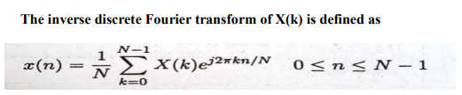
Inverse Discrete Fourier Transform

Slide 16
Unitary transform
Unitary Transform= A discrete linear transform is unitary if its transform matrix conforms to the unitary condition
A × A^{H} = I
where A = transformation matrix,
A^{H} represents Hermitian matrix.
A^{H}= A^{*T}
I = identity matrix
When the transform matrix A is unitary, the defined transform is called unitary transform

Slide 17
Orthogonal DFT
If A is unitary and has only real elements , then it is orthogonal matrix
A is orthogonal if A.A’ = I

Slide 18
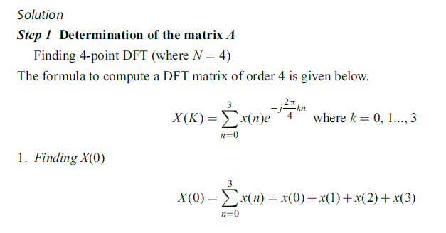
Image Transform
1) Check whether the DFT matrix is unitary or not.

Slide 19
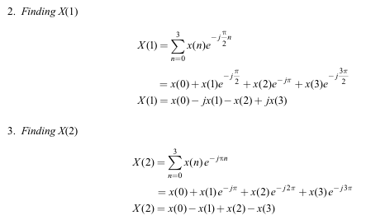

Slide 20
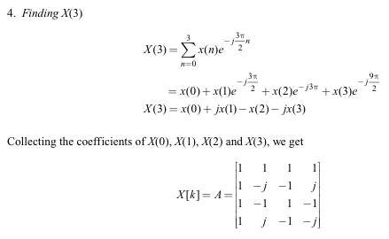

Slide 21
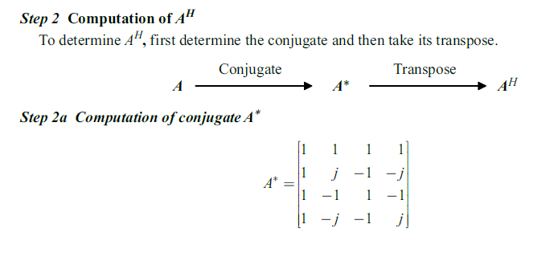

Slide 22
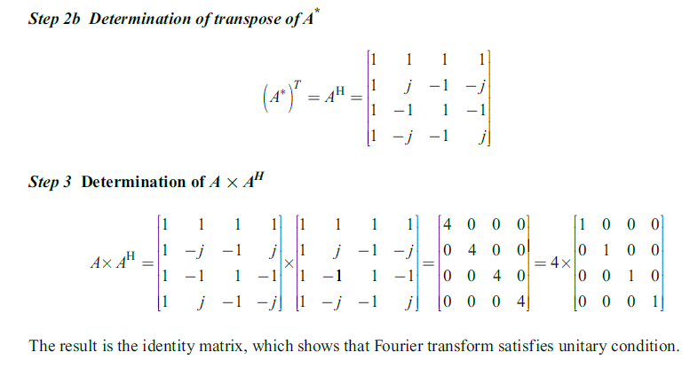

Slide 23
Unitary Transform
unitary transformation preserves the signal energy
Most unitary transforms pack a large fraction of the energy of the image into relatively few of the transform coefficients.
Few of the transform coefficients have significant values and these are the coefficients that are close to the origin

Slide 24
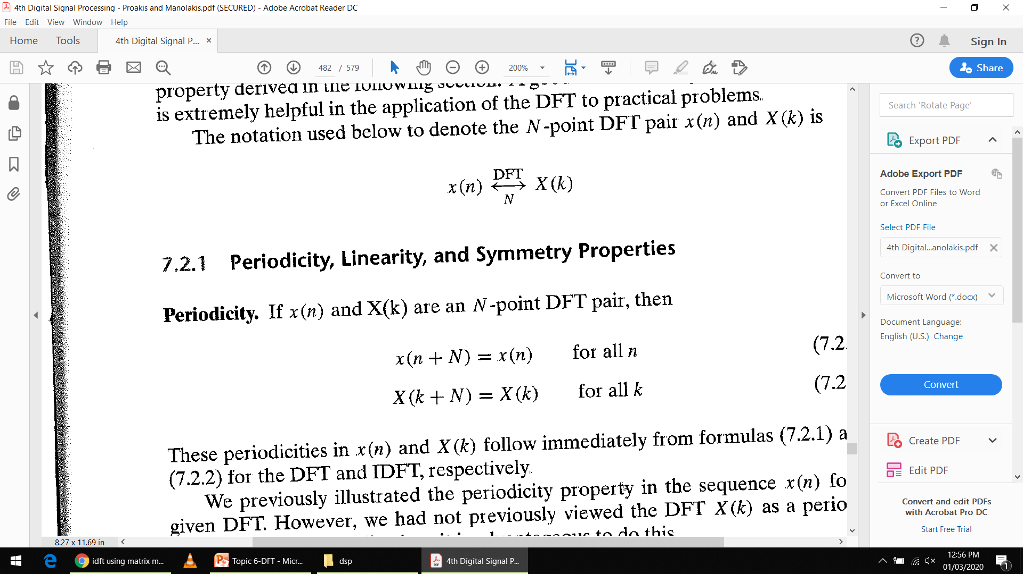
Properties of DFT-
Periodicity

Slide 25
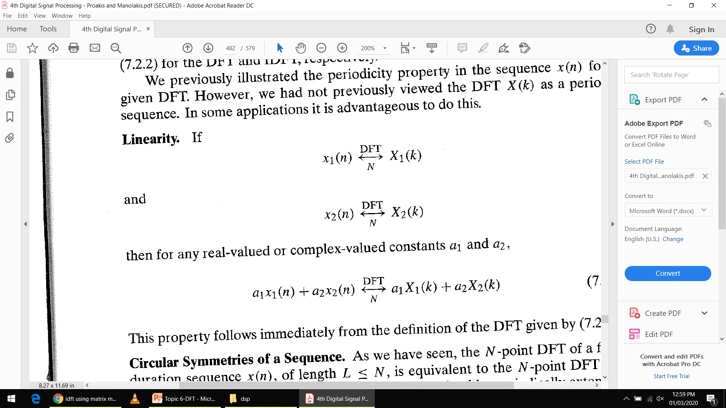
Properties of DFT
Linearity

Slide 26
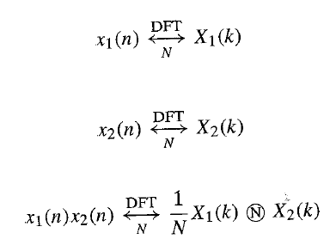
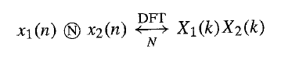
Properties of DFT
Circular Convolution

Slide 27
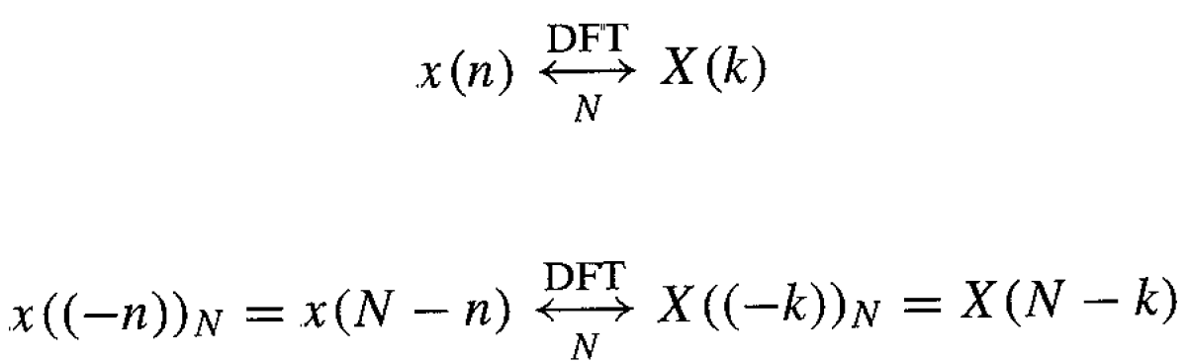
Properties of DFT
Time reversal
If the sequence is circularly folded , its DFT is also circularly folded.

Slide 28
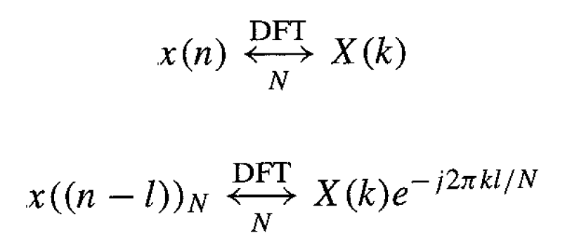
Properties of DFT
Time shift

Slide 29
Properties of DFT
Conjugation
DFT of complex conjugate of any sequence is equal to complex conjugate of DFT of that sequence , with sequence delayed by k samples in frequency domain.
DFT{x(n)}=X(k)
DFT{X*(n)}=X*(N-k)

Slide 30
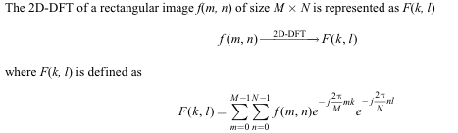
2D DISCRETE FOURIER TRANSFORM

Slide 31
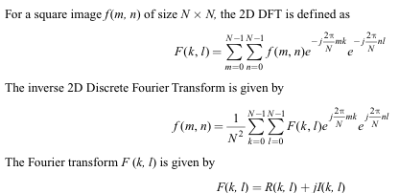
where R(k, l ) represents the real part of the spectrum and I(k, l) represents the imaginary part

Slide 32
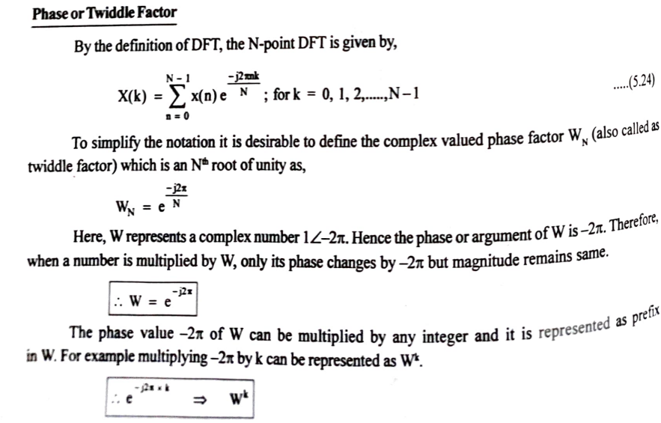
Twiddle factor

Slide 33
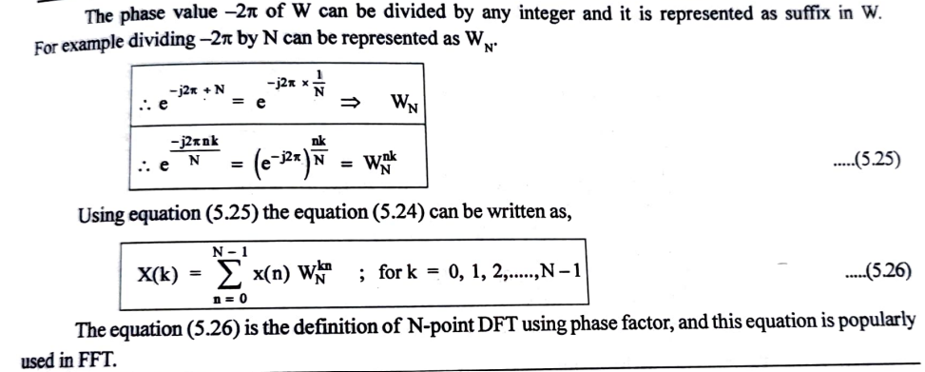
Twiddle factor

Slide 34

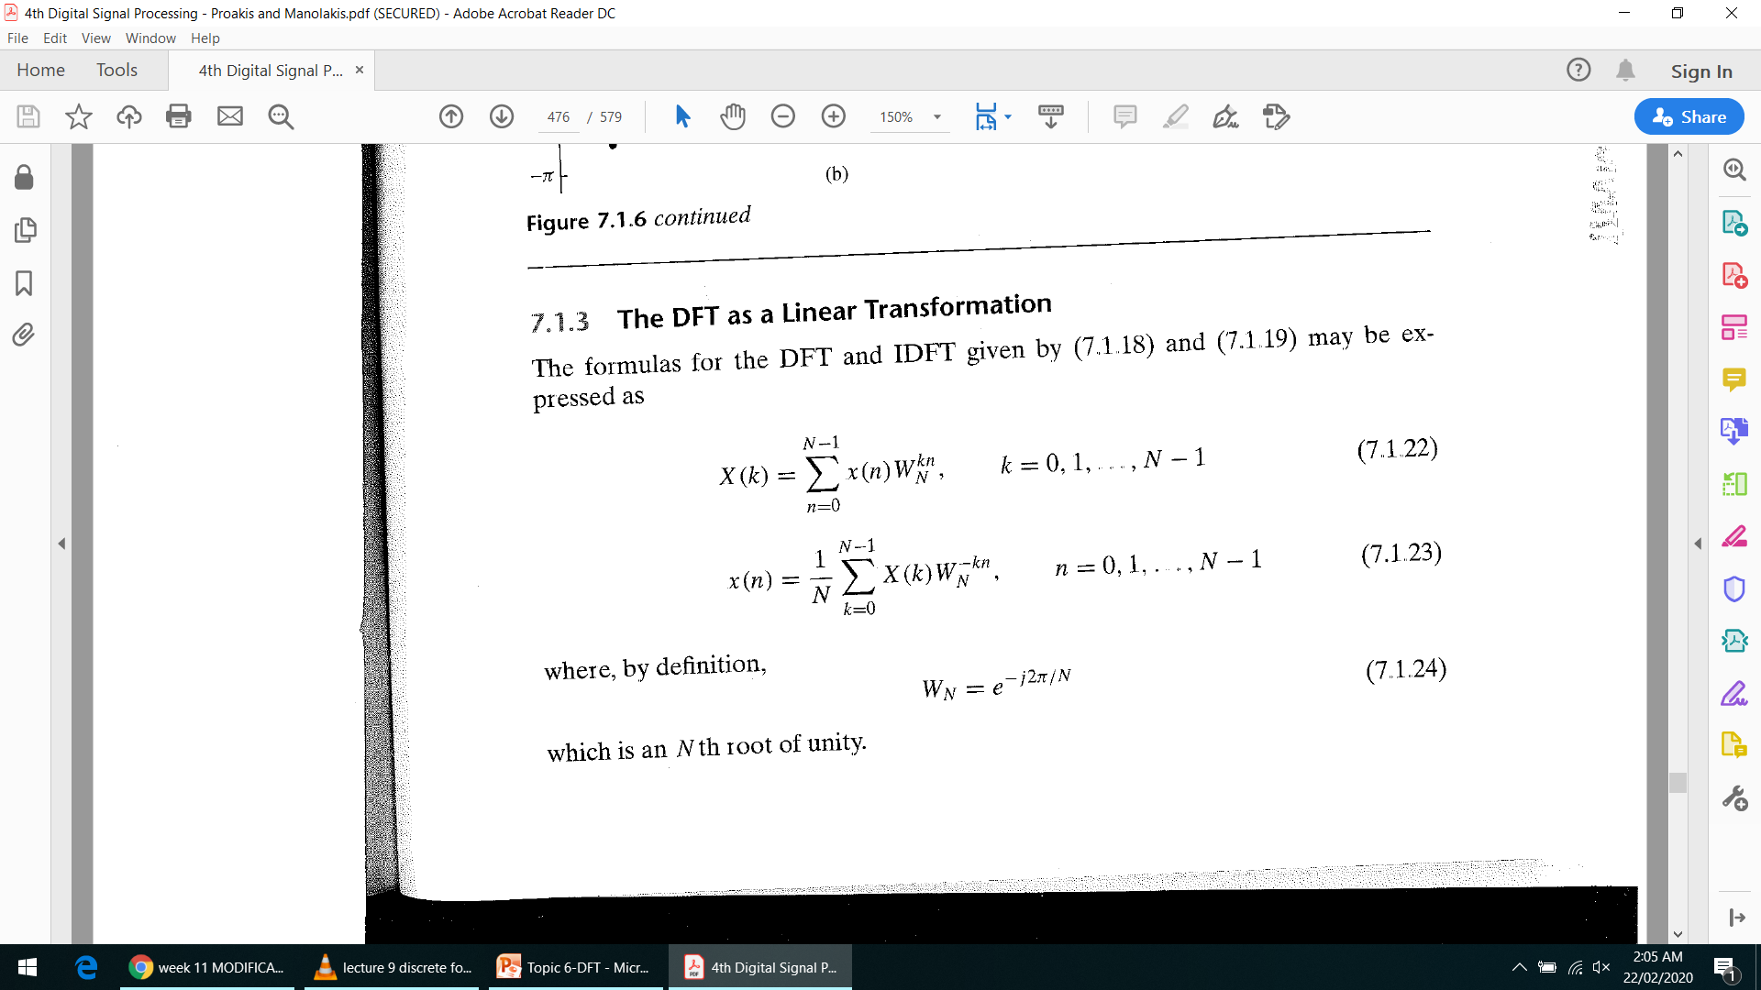
Twiddle Factor

Slide 35
DFT:
For N of length 4,range of n, k = [0 1 2 3] each.
Hence X(n) = x(0)W_{N}^{n.0}+x(1)W_{N}^{n.1}+x(2)W_{N}^{n.2} + x(3)W_{N}^{n.3}
 |  | x(0) | x(1) | x(2) | x(3)
X(0) | = | W₄^{0x0} | W₄^{0x1} | W₄^{0x2} | W₄^{0x3}
X(1) | = | W₄^{1x0} | W₄^{1x1} | W₄^{1x2} | W₄^{1x3}
X(2) | = | W₄^{2x0} | W₄^{2x1} | W₄^{2x2} | W₄^{2x3}
X(3) | = | W₄^{3x0} | W₄^{3x1} | W₄^{3x2} | W₄^{3x3}

Slide 36
 |  | x(0) | x(1) | x(2) | x(3)
X(0) | = | W₄^{0x0} | W₄^{0x1} | W₄^{0x2} | W₄^{0x3}
X(1) | = | W₄^{1x0} | W₄^{1x1} | W₄^{1x2} | W₄^{1x3}
X(2) | = | W₄^{2x0} | W₄^{2x1} | W₄^{2x2} | W₄^{2x3}
X(3) | = | W₄^{3x0} | W₄^{3x1} | W₄^{3x2} | W₄^{3x3}
Can be rewritten as:
 |  | x(0) | x(1) | x(2) | x(3)
X(0) | = | W₄⁰ | W₄⁰ | W₄⁰ | W₄⁰
X(1) | = | W₄⁰ | W₄¹ | W₄² | W₄³
X(2) | = | W₄⁰ | W₄² | W₄⁴ | W₄⁶
X(3) | = | W₄⁰ | W₄³ | W₄⁶ | W₄⁹

Slide 37
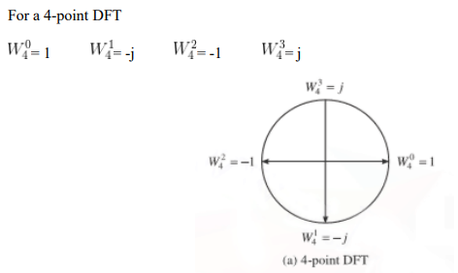
Cyclic property of twiddle factors
The "cyclic property" of twiddle factors means that their values repeat periodically, meaning that the sequence of twiddle factors for a given FFT size will repeat after a certain number of cycles, which is equal to the size of the DFT (N) itself; essentially, the values "wrap around" and start repeating again, allowing for efficient computation in FFT algorithms by reusing calculated values.

Slide 38
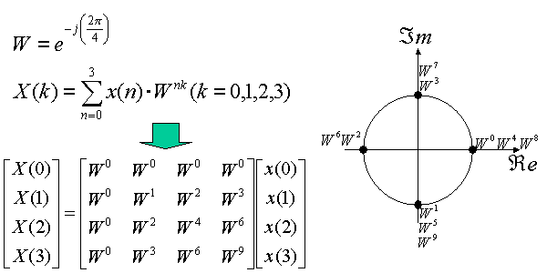
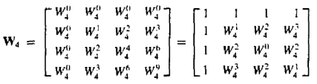

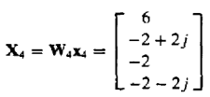
Compute the DFT of the four-point sequence x(n)={0,1,2,3}

Slide 39
The effective determinant of above is 1/4.
Conversion in system matrices of DFT and IDFT obtained by replacing by j by –j.
Inversion of above matrix is:

Slide 40

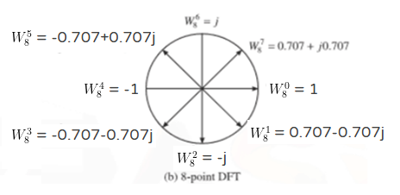








Cyclic property of twiddle factors
For an 8-point DFT
$$W_{4}^{14}$$
$$W_{4}^{13}$$
$$W_{4}^{15}$$
$$W_{4}^{12}$$
$$W_{4}^{8}$$
$$W_{4}^{9}$$
$$W_{4}^{11}$$
$$W_{4}^{10}$$

Slide 41
FOR 8 point DFT: N=8
The system Matrix is:
W₈^{0x0} | W₈^{0x1} | W₈^{0x2} | W₈^{0x3} | W₈^{0x4} | W₈^{0x5} | W₈^{0x6} | W₈^{0x7}
W₈^{1x0} | W₈^{1x1} | W₈^{1x2} | W₈^{1x3} | W₈^{1x4} | W₈^{1x5} | W₈^{1x6} | W₈^{1x7}
W₈^{2x0} | W₈^{2x1} | W₈^{2x2} | W₈^{2x3} | W₈^{2x4} | W₈^{2x5} | W₈^{2x6} | W₈^{2x7}
W₈^{3x0} | W₈^{3x1} | W₈^{3x2} | W₈^{3x3} | W₈^{3x4} | W₈^{3x5} | W₈^{3x6} | W₈^{3x7}
W₈^{4x0} | W₈^{4x1} | W₈^{4x2} | W₈^{4x3} | W₈^{4x4} | W₈^{4x5} | W₈^{4x6} | W₈^{4x7}
W₈^{5x0} | W₈^{5x1} | W₈^{5x2} | W₈^{5x3} | W₈^{5x4} | W₈^{5x5} | W₈^{5x6} | W₈^{5x7}
W₈^{6x0} | W₈^{6x1} | W₈^{6x2} | W₈^{6x3} | W₈^{6x4} | W₈^{6x5} | W₈^{6x6} | W₈^{6x7}
W₈^{7x0} | W₈^{7x1} | W₈^{7x2} | W₈^{7x0} | W₈^{7x4} | W₈^{7x5} | W₈^{7x6} | W₈^{7x7}

Slide 42
The characteristic matrix of 8-point DFT is:

Slide 43
DFT and its Inverse Conversion in system matrices of DFT and IDFT obtained by replacing by j by –j..
DFT
Effective
determinant
IDFT

Slide 44

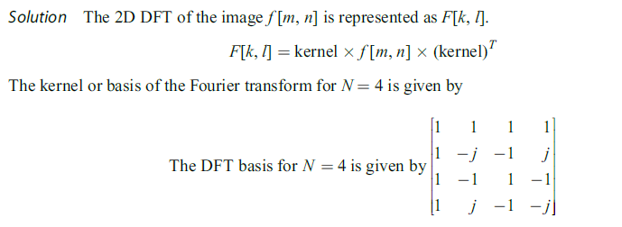
DFT of Image Matrix (2D)

Slide 45
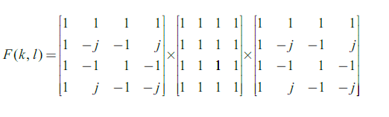
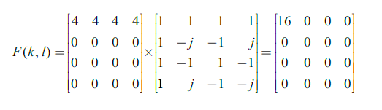
DFT of Image Matrix (2D)

Slide 46
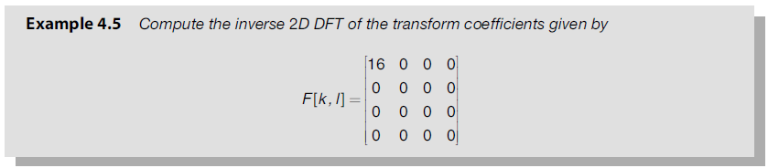

Slide 47
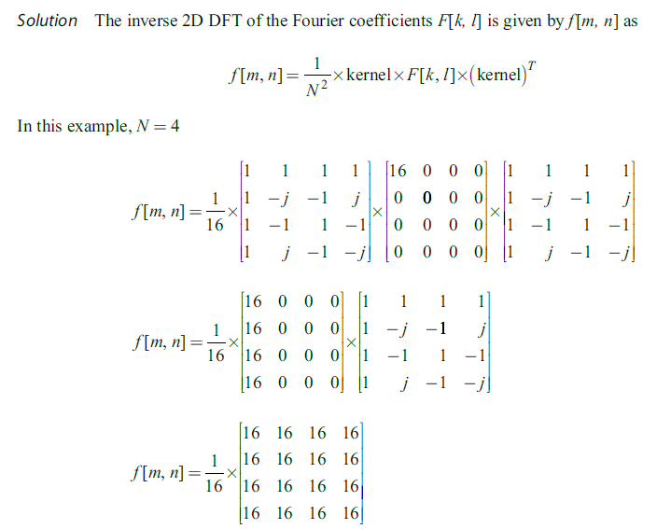

Slide 48
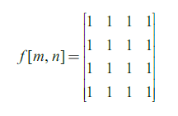

Slide 49
Fast Fourier Transform
FFT is method of computing DFT with reduced number of calculations.
Computational efficiency is achieved if we adopt a divide and conquer approach.
Approach is based on decomposition of N point DFT into successively smaller DFTs.

Slide 50
FFT-Divide & Conquer
Size 8 DFT
p = 2 (radix 2)
Size 4 DFT
Size 4 DFT
Size 2 DFT
Size 2 DFT
Size 2 DFT
Size 2 DFT

Slide 51
Radix-2 FFT
Radix-x: here ‘x’ represents number of samples in each group made at the first stage. They are generally equal.
N=2^m
m is number of stages
N point sequence is decimated into 2 point sequences, further from the results of 2 point DFTs, the 4 point DFTs can be computed and so on.

Slide 52
Radix -2
Radix-2 is the first FFT algorithm. It was proposed by Cooley and Tukey in 1965.
The algorithms appear either in
(a) Decimation In Time (DIT),
(b) Decimation In Frequency (DIF).
DIT and DIF, both yield same complexity and results. They are complementary.
We shall stress on 8 to radix 2 DIT FFT

Slide 53
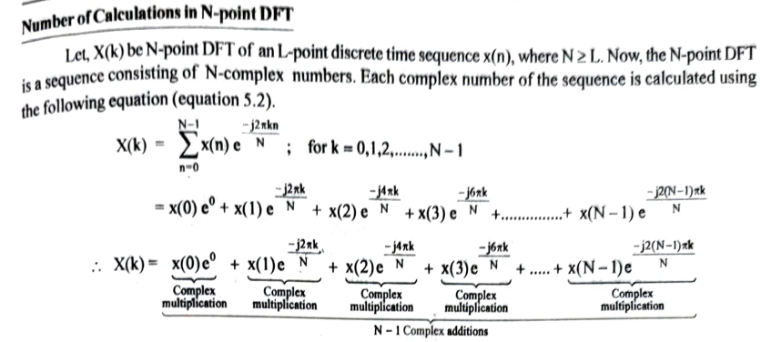
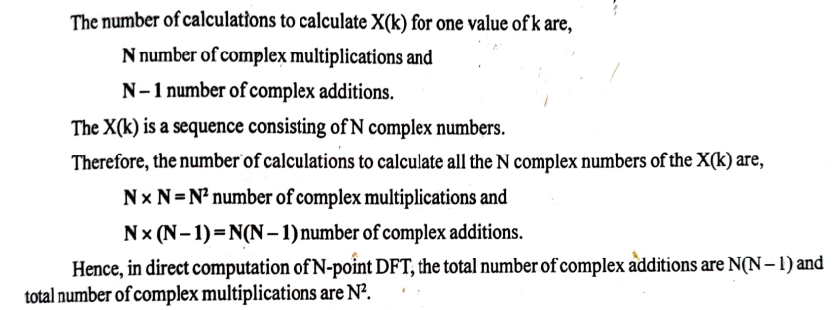
No. of Calculations in DFT

Slide 54
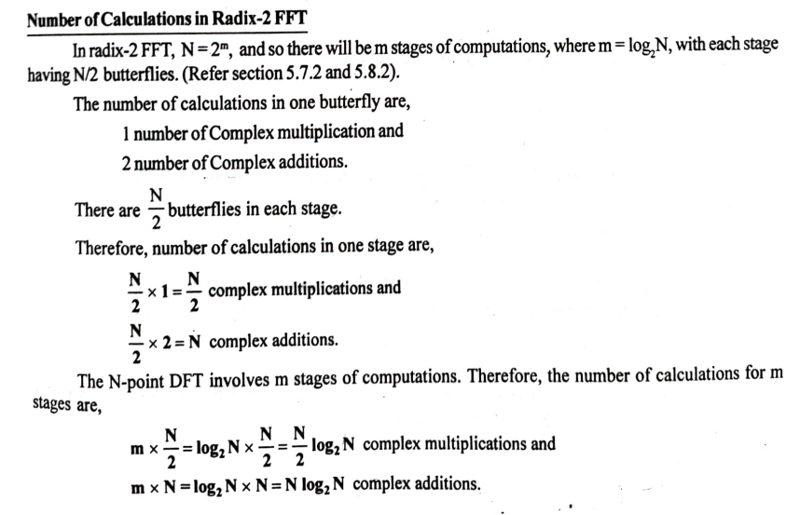
Size 8DFT
Size 4 DFT
Size 2 DFT
Size 2 DFT
Size 4 DFT
Size 2 DFT
Size 2 DFT

Slide 55
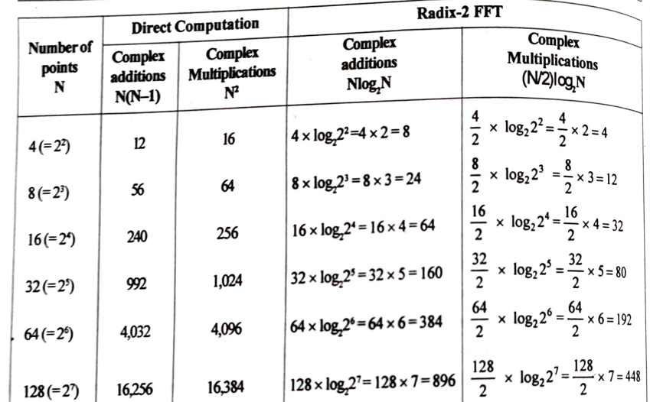

Slide 56
DIT- FFT Flowgraphs
The Radix-2 Decimation in Time (DIT) Fast Fourier Transform (FFT) is an efficient algorithm to compute the Discrete Fourier Transform (DFT). It reduces the computational complexity from O(N²) (in direct DFT computation) to O(N log₂N).
Steps to compute the DFT using Radix-2 DIT FFT:
Step 1: Check for Radix-2 Condition
Ensure that the number of input points, N, is a power of 2 (N = 2^m).
If N is not a power of 2, pad the sequence with zeros until it becomes a power of 2.

Slide 57
DIT- FFT Flowgraphs
Step 2: Bit-Reversal Permutation
Rearrange the input sequence x(n) into bit-reversed order.
The index positions of the input sequence are converted into their binary equivalents, then reversed, and finally mapped to the new sequence.
Step 3: Perform FFT Computation Using Butterfly Operations
The algorithm follows a divide-and-conquer approach by recursively breaking down the DFT into smaller computations.
The number of stages in the FFT is log₂N.
Each stage consists of multiple butterfly computations, where a butterfly operation processes two inputs to produce two outputs.

Slide 58
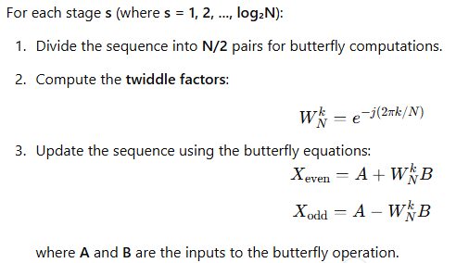
Step 4: Iterate for All Stages
Repeat the butterfly computations for log₂N stages.
The number of groups (or sub-DFTs) doubles at each stage, while the number of points per group halves.
Step 5: Output the Final FFT Coefficients
After completing log₂N stages, the transformed sequence X(k) represents the DFT of the input sequence x(n).

Slide 59
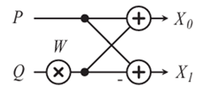
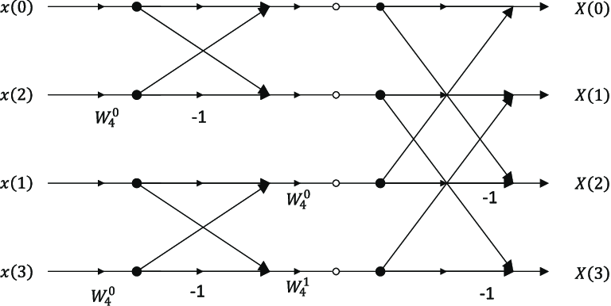
radix-2 DIT butterfly operation.
radix-4 DIT butterfly operation.

Slide 60
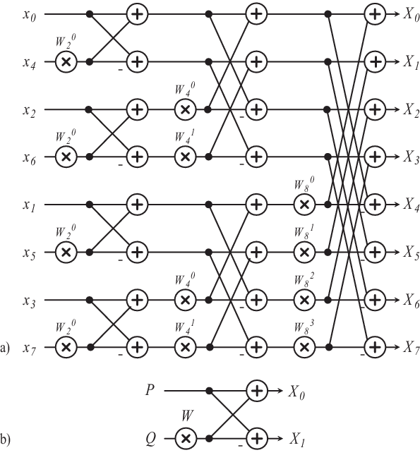
(a) Signal flow graph of 8-point radix-2 DIT FFT (b) radix-2 DIT butterfly operation.

Slide 61
Refer example 5.5, page 5.38 of digital signal processing, Nagoorkani

Slide 62
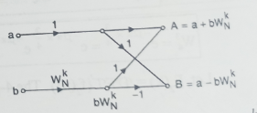
DIT-FFT
Steps to find DFT using Radix 2 DIT FFT:

Slide 63
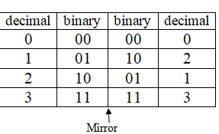

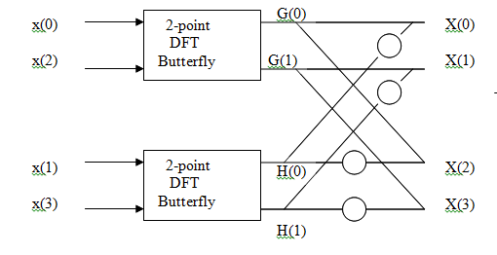

Ex: Draw the signal flow graph of the 4-point FFT, then use to it to find the spectrum of the sequence x(n)={1,-1,2,3}.
The even numbered samples are x(0) and x(2)
The odd numbered samples are x(1) and x(3)
X(0)=G(0)+W₄⁰ H(0)
X(1)=G(1)+W₄¹ H(1)
X(2)=G(0)+W₄² H(0)
X(3)=G(3)+W₄³ H(3)
And again G(3)=G(1)and H(3)=H(1), then:
X(3)=G(1)+W₄³ H(1)
E=

Slide 64
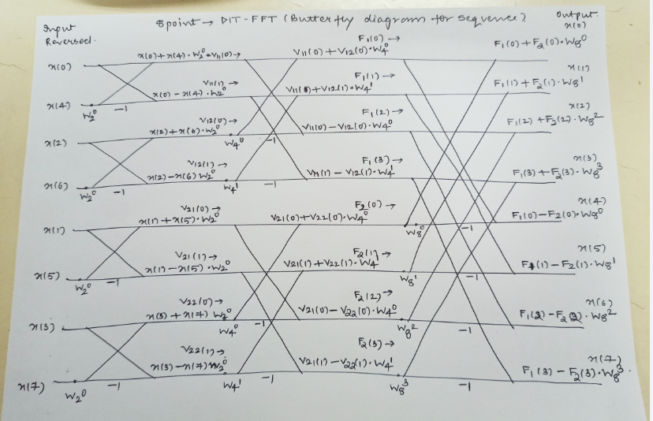

Slide 65
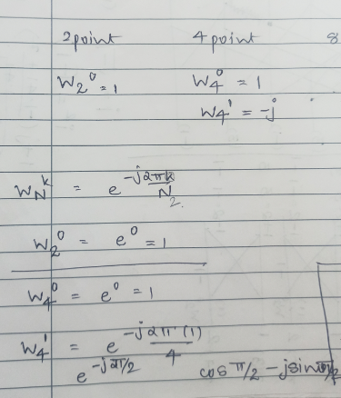

Slide 66
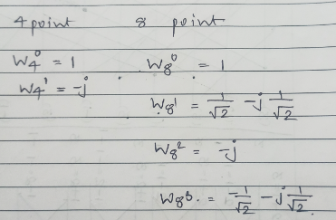

Slide 67
Discrete Cosine Transform (DCT)
The discrete cosine transforms are the members of a family of real-valued discrete sinusoidal unitary transforms.
A discrete cosine transform consists of a set of basis vectors that are sampled cosine functions.
DCT is a technique for converting a signal into elementary frequency components and it is widely used in image compression.

Slide 68



Slide 69


Slide 70


Slide 71


Slide 72



Slide 73


Slide 74


Slide 75

IDCT

Slide 76
Symmetric and Asymmetric
Transformation Matrix – T
Image Matrix – f
If Transformation matrix is symmetric:
F = TfT
If Transformation matrix is asymmetric:
F = TfT’

Slide 77


Hadamard Transform

Slide 78


Slide 79
Hadamard Transform
Hadamard of Sequence
X[n]={H(N).x(n)}
Inverse Hadamard of Sequence
x[n] = 1/N{H(N).X(n)}
Hadamard of image (2D)
Hadamard is symmetric transform
F = TfT

Slide 80



Slide 81

Walsh Transform

Slide 82

Haar Transform

Slide 83

Haar Transform

Slide 84
IMAGE ENHANCEMENT IN THE FREQUENCY DOMAIN
If we multiply each element of the Fourier coefficient by a suitably chosen weighting function then we can accentuate certain frequency components and attenuate others.
This selective enhancement or suppression of frequency components is termed Fourier filtering or frequency domain filtering.
The spatial representation of image data describes the adjacency relationship between the pixels.
On the other hand, the frequency domain representation clusters the image data according to their frequency distribution.
In frequency domain filtering, the image data is dissected into various spectral bands, where each band depicts a specific range of details within the image.
The process of selective frequency inclusion or exclusion is termed frequency domain filtering.
It is possible to perform filtering in the frequency domain by specifying the frequencies that should be kept and the frequencies that should be discarded.

Slide 85

IMAGE ENHANCEMENT IN THE FREQUENCY DOMAIN
f(m,n) – original image
F(k,l) – FT of original image
h(m,n) – Filtering mask
H(k,l) – FT of filtering mask

Slide 86

1. Low pass filter:
1. Low pass filter removes the high frequency components that means it keeps low frequency components. It is used for smoothing the image. It is used to smoothen the image by attenuating high frequency components and preserving low frequency components.
Mechanism of low pass filtering in frequency domain is given by:
G(u, v) = H(u, v) . F(u, v)
where F(u, v) is the Fourier Transform of original image
and H(u, v) is the Fourier Transform of filtering mask

Slide 87
1. Low pass filter:
2. High pass filter: High pass filter removes the low frequency components that means it keeps high frequency components. It is used for sharpening the image. It is used to sharpen the image by attenuating low frequency components and preserving high frequency components.
Mechanism of high pass filtering in frequency domain is given by:
H(u, v) = 1 - H'(u, v)
where H(u, v) is the Fourier Transform of high pass filtering
and H'(u, v) is the Fourier Transform of low pass filtering

Slide 88
1. Low pass filter:
3. Band pass filter: Band pass filter removes the very low frequency and very high frequency components that means it keeps the moderate range band of frequencies. Band pass filtering is used to enhance edges while reducing the noise at the same time.
Band pass filter removes the very low frequency and very high frequency components that means it keeps the moderate range band of frequencies. Band pass filtering is used to enhance edges while reducing the noise at the same time.

Slide 89
Low Pass (LP) Filters
Ideal low-pass filter (ILPF)
Butterworth low-pass filter (BLPF)
Gaussian low-pass filter (GLPF)

Slide 90
Ideal Low-pass (LP) filtering
Preserves low frequencies, attenuates high frequencies.
Cut off all high-frequency components of the Fourier transform that are at a distance greater than a specified distance D₀ (cut off frequency) from the origin of the (centered) transform
The transfer function (frequency domain filter) is defined by
D(u,v) is the distance from point (u,v) to the origin (center) of the frequency domain filter
Usually, the image to be filtered is even-sized, in this case, the center of the filter is (M/2,N/2). Then the distance D(u,v) can be obtained by

Slide 91

Ideal Low-pass (LP) filtering
How to determine the cutoff frequency D₀?
One way to do this is to compute circles that enclose specified amounts of total image power P_{T}.

Slide 92

How does D₀ control smoothing? (cont’d)
D₀ controls the amount of blurring
r=78 (99%)
r=8 (90%)

Slide 93


Ringing Effect
Sharp cutoff frequencies produce an overshoot of image features whose frequency is close to the cutoff frequencies (ringing effect).
h=f*g

Slide 94


Ringing effect is clear in most cases except for the last one.
Ringing effect is the consequence of applying ideal lowpass filters
Ringing effect is clear in most cases except for the last one.
Ringing effect is the consequence of applying ideal lowpass filters

Slide 95

Butterworth Lowpass Filters
A butterworth lowpass filter (BLPF) of order n with cutoff frequency at a distance D₀ from the origin is given by the following transfer function
BLPF does not have a sharp discontinuity
For BLPF, the cutoff frequency is defined as the frequency at which the transfer function has value which is half of the maximum

Slide 96

Examples of Application of BLPF
Same order but with different cutoff frequencies
The larger the cutoff frequency, the more details are reserved

Slide 97

Butterworth LPF

Slide 98

Butterworth LP filter (BLPF)
In practice, we use filters that attenuate high frequencies smoothly (e.g., Butterworth LP filter) → less ringing effect
n=1
n=4
n=16

Slide 99
Spatial Representation of BLPFs
n=1 n=2 n=5 n=20

Slide 100

Comparison: Ideal LP and BLPF
ILPF
BLPF
D₀=10, 30,
60, 160,
460
D₀=10, 30,
60, 160,
460
n=2

Slide 101

Gaussian Lowpass Filters
GLPF is given by the following (centered ) transfer function
(u₀,v₀) is the center of the transfer function
It is [M/2, N/2] if M,N are even and [(M+1)/2,(N+1)/2] if M,N are odd numbers
Dose GLPF suffer from the ringing effect?

Slide 102
Example: smoothing by GLPF (1)

Slide 103

Examples of smoothing by GLPF (2)
D₀=100
D₀=80

Slide 104

High-Pass filtering
A high-pass filter can be obtained from a low-pass filter using:
= 1 -
D₀

Slide 105
High-pass filtering (cont’d)
Preserves high frequencies, attenuates low frequencies.

Slide 106

Butterworth high pass filter (BHPF)
In practice, we use filters that attenuate low frequencies smoothly (e.g., Butterworth HP filter) → less ringing effect

Slide 107


Comparison: IHPF and BHPF
IHPF
D₀=30,60,160
D₀=30,60,160
BHPF
n=2

Slide 108

Gaussian HP filter
GHPF
BHPF

Slide 109

Comparison: BHPF and GHPF
BHPF
D₀=30,60,160
n=2
D₀=30,60,160
GHPF

Slide 110

Homomorphic filtering
Many times, we want to remove shading effects from an image (i.e., due to uneven illumination)
Enhance high frequencies
Attenuate low frequencies but preserve fine detail.

Slide 111
Homomorphic Filtering (cont’d)
Consider the following model of image formation:
In general, the illumination component i(x,y) varies slowly and affects low frequencies mostly.
In general, the reflection component r(x,y) varies faster and affects high frequencies mostly.
i(x,y): illumination
r(x,y): reflection
IDEA: separate low frequencies due to i(x,y)
from high frequencies due to r(x,y)

Slide 112
How are frequencies mixed together?
Low and high frequencies from i(x,y) and r(x,y)
are mixed together.
When applying filtering, it is difficult to handle
low/high frequencies separately.

Slide 113
Can we separate them?
Idea:
Take the ln( ) of

Slide 114
Steps of Homomorphic Filtering
(1) Take
(2) Apply FT:
or
(3) Apply H(u,v)

Slide 115


Steps of Homomorphic Filtering (cont’d)
(4) Take Inverse FT:
or
(5) Take exp( ) or

Slide 116
Example using high-frequency emphasis
Attenuate the contribution made by illumination and amplify the contribution made by reflectance
Attenuate the contribution made by illumination and amplify the contribution made by reflectance

Slide 117
Homomorphic Filtering: Example

Slide 118
Homomorphic Filtering: Example

Slide 119



PCA Steps:
Centre the data by subtracting off the mean
Choose the direction with largest variation, place an axis in that direction
Look at the remaining variations, find another axis that is that is orthogonal to the first axis and covers maximum variations

Slide 120

Standard deviation
Standard deviation, is simply the square root of the average square distance of data points to the mean. In the equation below, the numerator contains the sum of the differences between each datapoint and the mean, and the denominator is simply the number of data points (minus one), producing the average distance.

Slide 121

Variance
Variance is simply standard deviation squared, and is often expressed as s^2
For both variance and standard deviation, squaring the differences between data points and the mean makes them positive, so that values above and below the mean don’t cancel each other out.

Slide 122
Covariance
Variance and Covariance are a measure of the “spread” of a set of points around their center of mass (mean)
• Variance – measure of the deviation from the mean for points in one dimension e.g. heights
• Covariance as a measure of how much each of the dimensions vary from the mean with respect to each other.
• Covariance is measured between 2 dimensions to see if there is a relationship between the 2 dimensions e.g. number of hours studied & marks obtained.
• The covariance between one dimension and itself is the variance

Slide 123

Covariance
So, if you had a 3-dimensional data set (x,y,z), then you could measure the covariance between the x and y dimensions, the y and z dimensions, and the x and z dimensions.
Measuring the covariance between x and x , or y and y , or z and z would give you the variance of the x , y and z dimensions respectively.

Slide 124

Covariance Matrix
Representing Covariance between dimensions as a matrix e.g. for 3 dimensions:
$$C=\left[\begin{matrix}cov\left(x,x\right) & cov\left(x,y\right) & cov\left(x,z\right) \\ cov\left(y,x\right) & cov\left(y,y\right) & cov\left(y,z\right) \\ cov\left(z,x\right) & cov\left(z,y\right) & cov\left(z,z\right)\end{matrix}\right]$$
• Diagonal is the variances of x, y and z
• cov(x,y) = cov(y,x) hence matrix is symmetrical about the diagonal
• N-dimensional data will result in NxN covariance matrix

Slide 125
Covariance
Exact value is not as important as it’s sign.
(+) A positive value of covariance indicates both dimensions increase or decrease together e.g. as the number of hours studied increases, the marks in that subject increase.
(-) A negative value indicates while one increases the other decreases, or vice-versa e.g. time spent on social media vs performance in exam.
(zero) If covariance is zero: the two dimensions are independent of each other e.g. heights of students vs the marks obtained in a subject

Slide 126
Covariance
Why bother with calculating covariance when we could just plot the 2 values to see their relationship?
Ans:
Covariance calculations are used to find relationships between dimensions in high dimensional data sets (usually greater than 3) where visualization is difficult.

Slide 127

Eigen vectors
$M=\left[\begin{matrix}2 & 3 \\ 2 & 1\end{matrix}\right]×\left[\begin{matrix}1 \\ 3\end{matrix}\right]=\left[\begin{matrix}11 \\ 5\end{matrix}\right]$ The resulting vector is not integer multiple of the original vector
$N=\left[\begin{matrix}2 & 3 \\ 2 & 1\end{matrix}\right]×\left[\begin{matrix}3 \\ 2\end{matrix}\right]=\left[\begin{matrix}12 \\ 8\end{matrix}\right]=4×\left[\begin{matrix}3 \\ 2\end{matrix}\right]$ The resulting vector is exactly 4 times the original vector. This is called eigenvector.
We can transform and change matrices into new vectors by multiplying a matrix with a vector. The multiplication of the matrix by a vector computes a new vector. This is the transformed vector.

Slide 128
Eigenvector
If the new transformed vector is just a scaled form of the original vector then the original vector is known to be an eigenvector of the original matrix
An eigenvector is a vector that does not change when a transformation is applied to it, except that it becomes a scaled version of the original vector.
Eigenvalue— The scalar that is used to transform (stretch) an Eigenvector.

Slide 129

Eigenvector and Eigenvalue
An eigenvector does not change direction in a transformation:
In this shear mapping the red arrow changes direction, but the blue arrow does not. The blue arrow is an eigenvector of this shear mapping because it does not change direction, and since its length is unchanged, its eigenvalue is 1.
1 means no change,
2 means doubling in length,
−1 means pointing backwards along the eigenvalue's direction

Slide 130


The Mathematics
For a square matrix A, an Eigenvector and Eigenvalue make this equation true:

Slide 131
How do we find these eigen things?
We start by finding the eigenvalue:
we know this equation must be true: Av = λv
Now let us put in an identity matrix so we are dealing with matrix-vs-matrix:
Av = λIv
Bring all to left hand side:
Av − λIv = 0
If v is non-zero then we can solve for λ using just the determinant:
| A − λI | = 0
Let's try that equation on our previous example:

Slide 132


Slide 133



Slide 134
PCA
Principal components analysis (PCA) is a technique that can be used to simplify a dataset
• It is a linear transformation that chooses a new coordinate system for the data set such that greatest variance by any projection of the data set comes to lie on the first axis (then called the first principal component),the second greatest variance on the second axis, and so on.
• PCA can be used for reducing dimensionality by eliminating the later principal components.

Slide 135
Steps Involved in the PCA
Step 1: Standardize the dataset.
Step 2: Calculate the covariance matrix for the features in the dataset.
Step 3: Calculate the eigenvalues and eigenvectors for the covariance matrix.
Step 4: Sort eigenvalues and their corresponding eigenvectors.
Step 5: Pick k eigenvalues and form a matrix of eigenvectors.
Step 6: Transform the original matrix.

Slide 136

Example
1. Standardize the Dataset
Assume we have the below dataset which has 4 features and a total of 5 training examples.

Slide 137



Example
First, we need to standardize the dataset and for that, we need to calculate the mean and standard deviation for each feature.
After applying the formula for each feature in the dataset is transformed as below:

Slide 138


Example
2. Calculate the covariance matrix for the whole dataset
The formula to calculate the covariance matrix:
Since we have standardized the dataset, so the mean for each feature is 0 and the standard deviation is 1.

Slide 139
Example
var(f1) = ((-1.0-0)² + (0.33-0)² + (-1.0-0)² +(0.33–0)² +(1.33–0)²)/5 var (f1) = 0.8
cov(f1,f2) =((-1.0–0)*(-0.632456-0) + (0.33–0)*(1.264911-0) + (-1.0–0)* (0.632456-0)+ (0.33–0)*(0.000000 -0)+ (1.33–0)*(-1.264911–0))/5 cov(f1,f2) = -0.25298

Slide 140

Example
In the similar way be can calculate the other covariances and which will result in the below covariance matrix

Slide 141
Example
3. Calculate eigenvalues and eigen vectors.
Aν-λIν =0 ;
(A-λI)ν = 0
Since we already know ν is a non- zero vector, only way this equation can be equal to zero, if
det(A-λI) = 0

Slide 142


Example
$$\left[\begin{matrix}\begin{matrix}0.8 & −0.25298 \\ −0.25298 & 0.8\end{matrix} & \begin{matrix}0.03849 & −0.14479 \\ 0.51121 & 0.4945\end{matrix} \\ \begin{matrix}0.03849 & 0.51121 \\ −0.14479 & 0.4945\end{matrix} & \begin{matrix}0.8 & 0.75236 \\ 0.75236 & 0.8\end{matrix}\end{matrix}\right]−λ\left[\begin{matrix}\begin{matrix}1 & 0 \\ 0 & 1\end{matrix} & \begin{matrix}0 & 0 \\ 0 & 0\end{matrix} \\ \begin{matrix}0 & 0 \\ 0 & 0\end{matrix} & \begin{matrix}1 & 0 \\ 0 & 1\end{matrix}\end{matrix}\right]=0$$
Solving the above equation |M|= 0
λ = 2.51579324 , 1.0652885 , 0.39388704 , 0.02503121

Slide 143

Example
Eigenvectors:
Solving the (A-λI)ν = 0 equation for ν vector with different λ values:
For λ = 2.51579324, solving the above equation using Cramer's rule, the values for v vector are
v1 = 0.16195986 v2 = -0.52404813 v3 = -0.58589647 v4 = -0.59654663

Slide 144

Example
Going by the same approach, we can calculate the eigen vectors for the other eigen values. We can from a matrix using the eigen vectors.
4. Sort eigenvalues and their corresponding eigenvectors.
Since eigenvalues are already sorted in this case so no need to sort them again.

Slide 145


Example
5. Pick k eigenvalues and form a matrix of eigenvectors
If we choose the top 2 eigenvectors, the matrix will look like this:
6. Transform the original matrix.
Feature matrix * top k eigenvectors = Transformed Data

Slide 146


Slide 147
Wavelet Transform
https://medium.com/@koushikc2000/2d-discrete-wavelet-transformation-and-its-applications-in-digital-image-processing-using-matlab-1f5c68672de3

